Slide 1

BMS COLLEGE OF ENGINEERING
(Autonomous Institute, Affiliated to VTU, Belagavi)
DEPARTMENT OF MACHINE LEARNING
(UG Program: B.E. in Artificial Intelligence and Machine Learning)
Course :Data Analytics and Visualization
Course Code: 24AM5CDAV
Alternative Assessment Tool
Date:
Global Disease Burden: A Tableau Analysis of Mortality Trends
Presented By,
Student Name & USN :
Mohd Ehteshaam Khan 1BM22AI078
Nithessh Kumar JS 1BM22AI085
Semester & Section: 5B
Faculty In-Charge:
Assistant Professor
Dr. Arun Sir
Department of Machine Learning
BMS College of Engineering

Slide 2
Details of Case Study
Objective : The primary objective of this study is to explore and visualize global disease mortality patterns, identifying trends, disparities, and areas of high concern through an analysis of the provided dataset
Data Source : https://www.kaggle.com/datasets/iamsouravbanerjee/cause-of-deaths-around-the-world?select=cause_of_deaths.csv
Key Questions Addressed:
How have the mortality rates for Alzheimer's, Cardiovascular diseases, Malaria, Meningitis, and Parkinson's disease changed over time at global level?"
Which countries experienced the highest and lowest disease mortality rates for each disease in 2020?
What geographic patterns can be observed in the distribution of disease mortality in 2020?
How does the distribution of disease mortalities compare across different regions of the world?
Are there any notable correlations or associations that can be identified by analyzing different visualizations?
Tools Used: Tableau

Slide 3
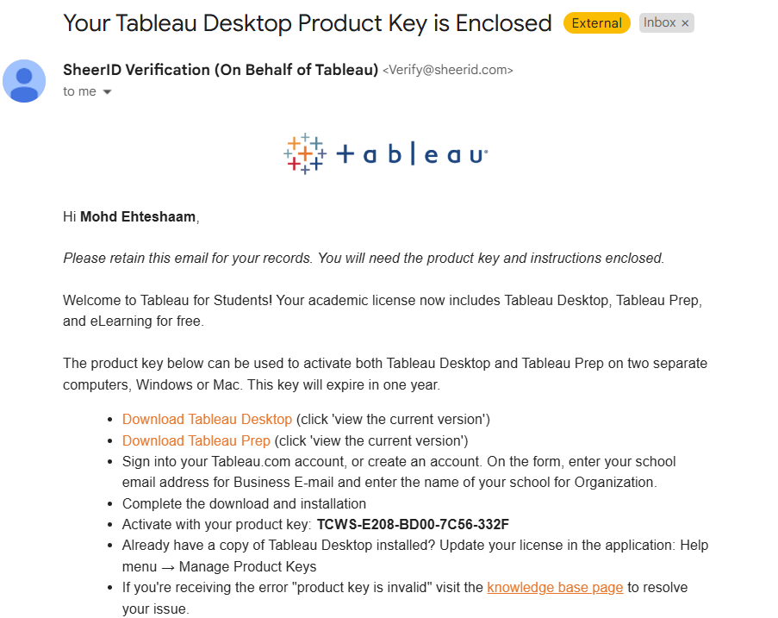

Screenshot TABLEAU Registration of each team member

Slide 4
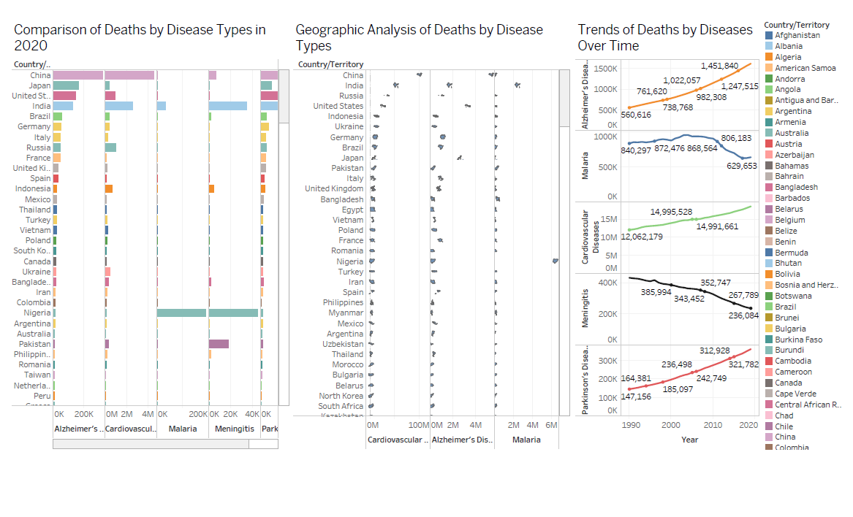
Implementation (Dashboard, Worksheet and Story) with screenshots

Slide 5
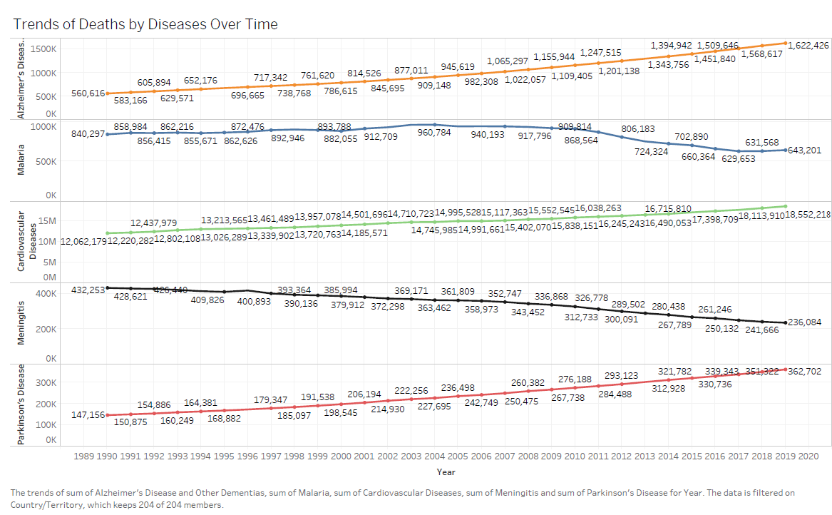
Implementation (Dashboard, Worksheet and Story) with screenshots

Slide 6
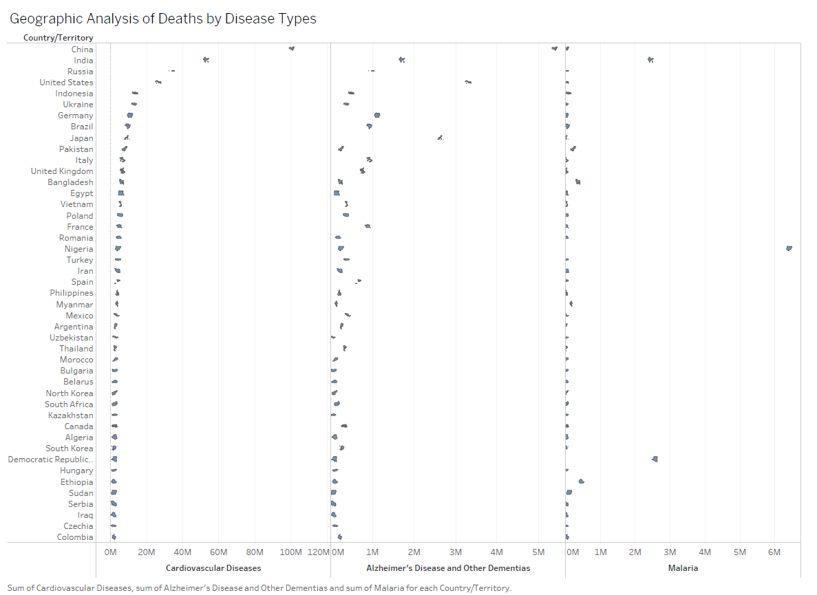
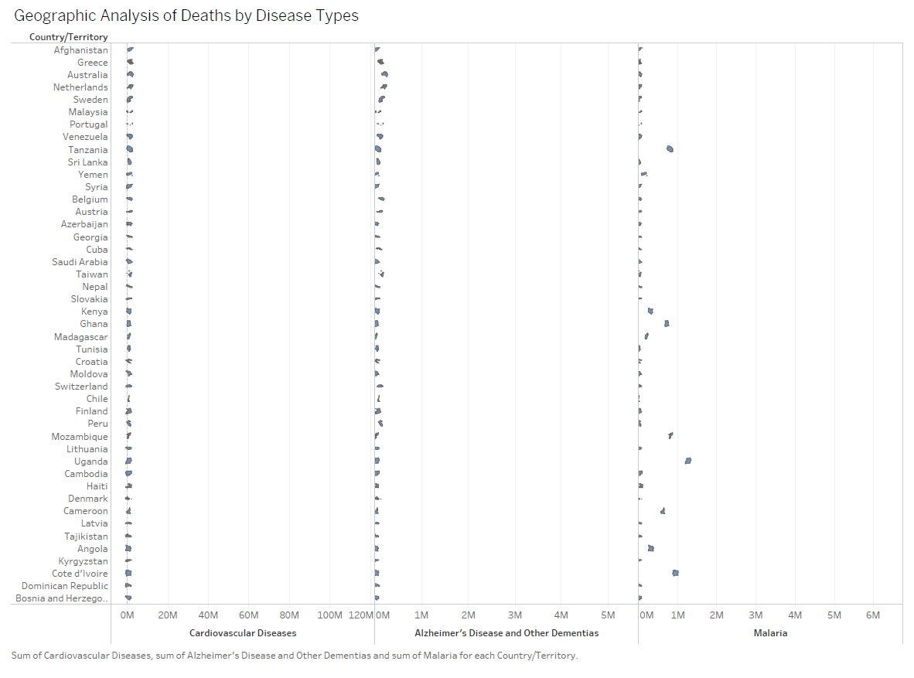
Implementation (Dashboard, Worksheet and Story) with screenshots

Slide 7
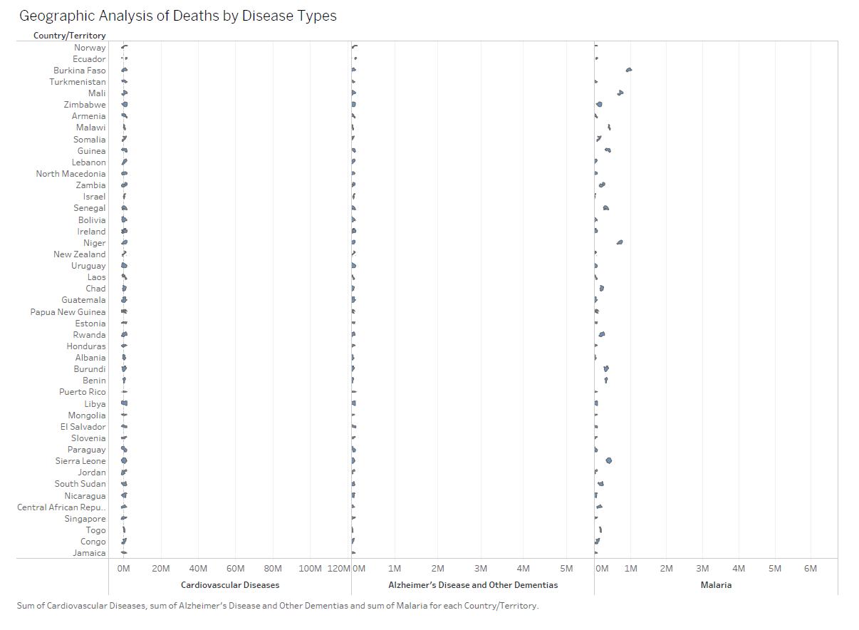
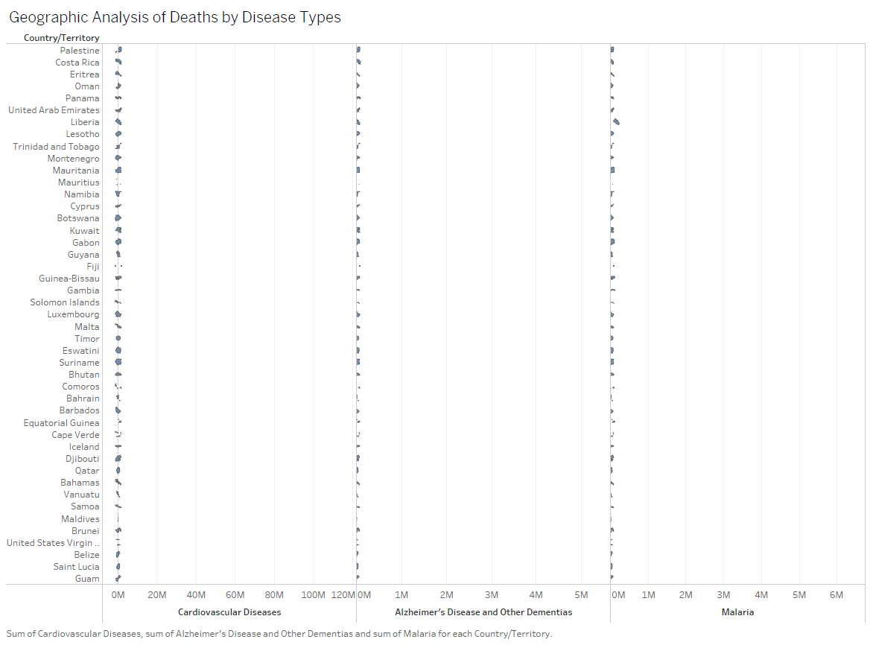
Implementation (Dashboard, Worksheet and Story) with screenshots

Slide 8
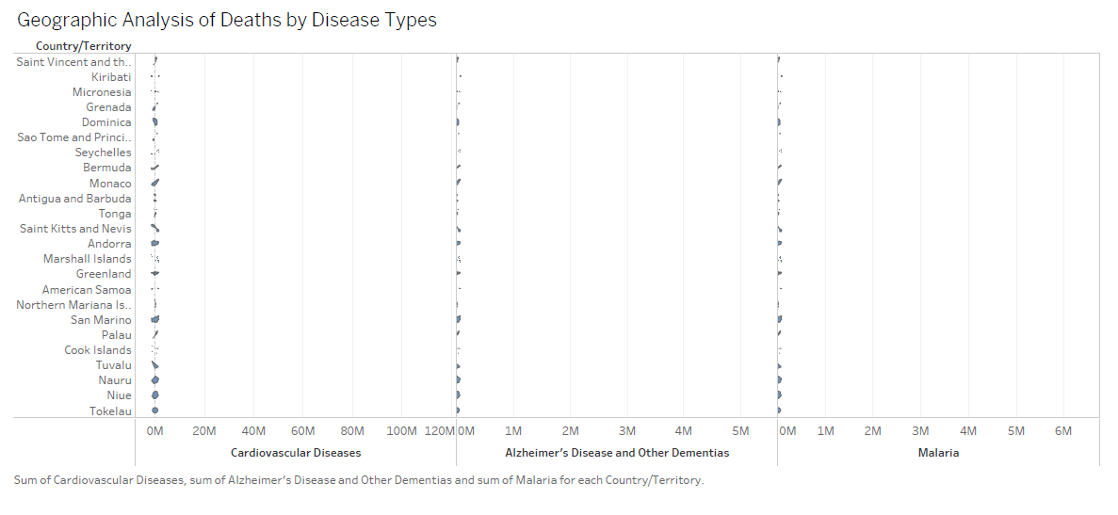
Implementation (Dashboard, Worksheet and Story) with screenshots

Slide 9
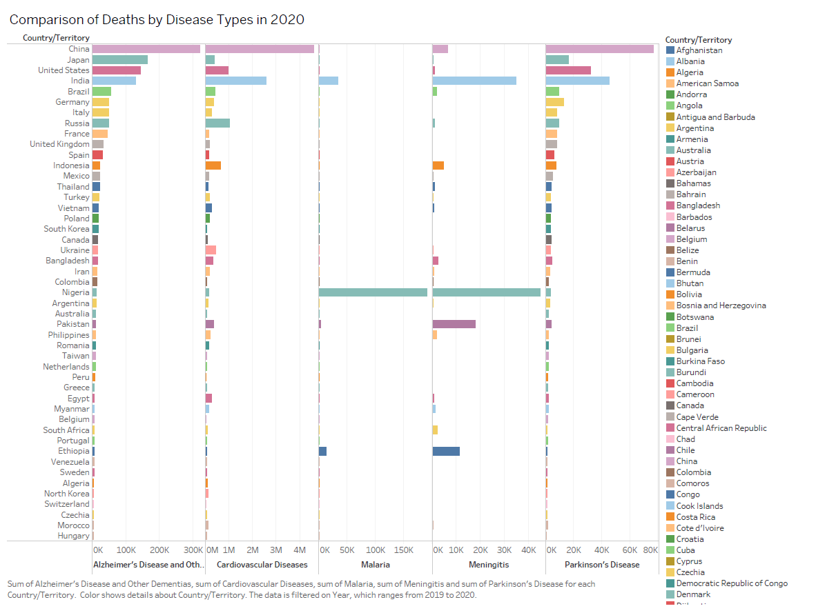
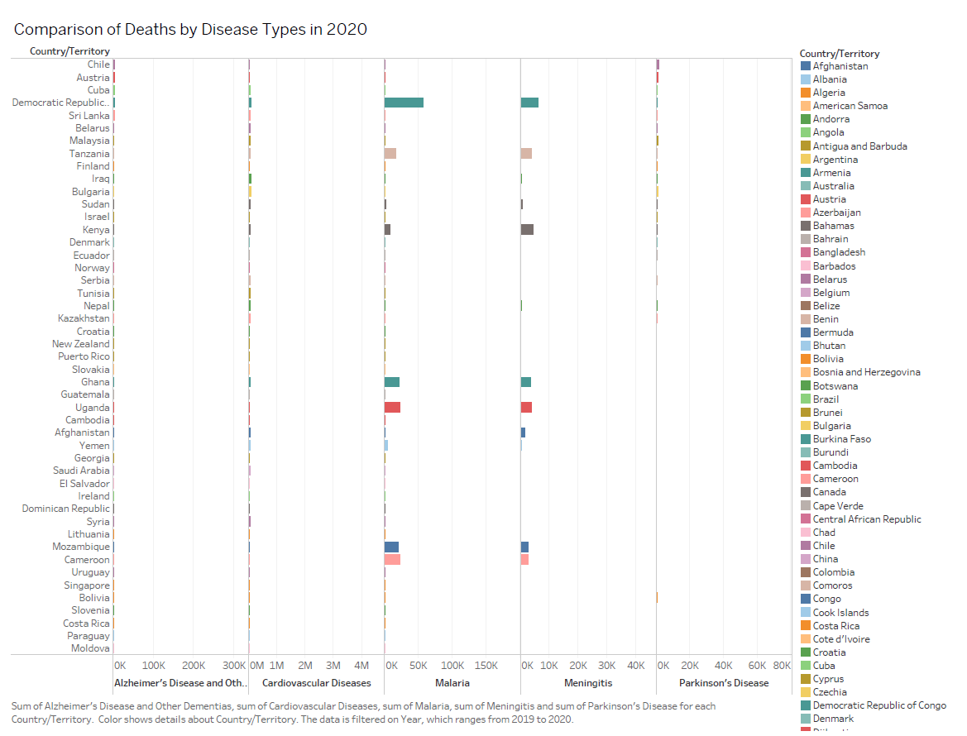
Implementation (Dashboard, Worksheet and Story) with screenshots

Slide 10
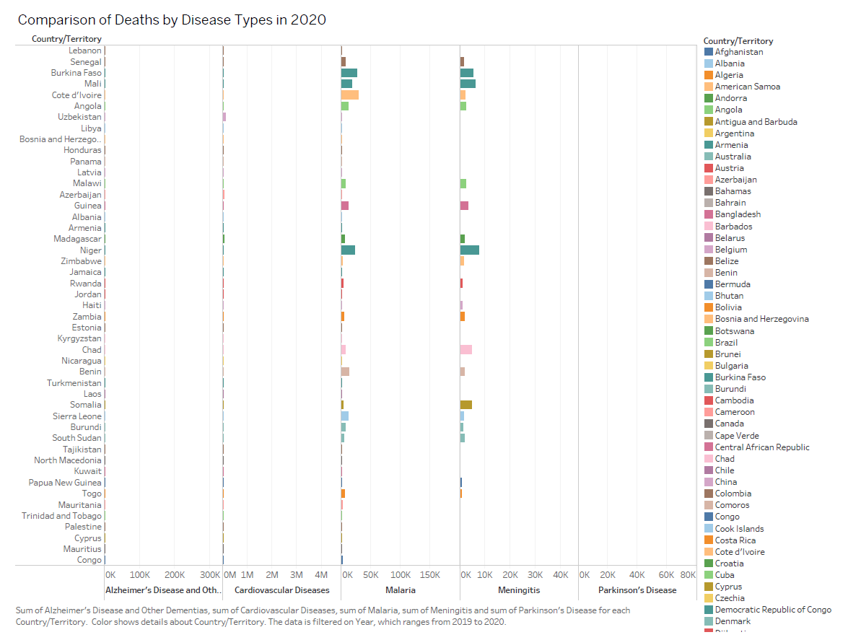
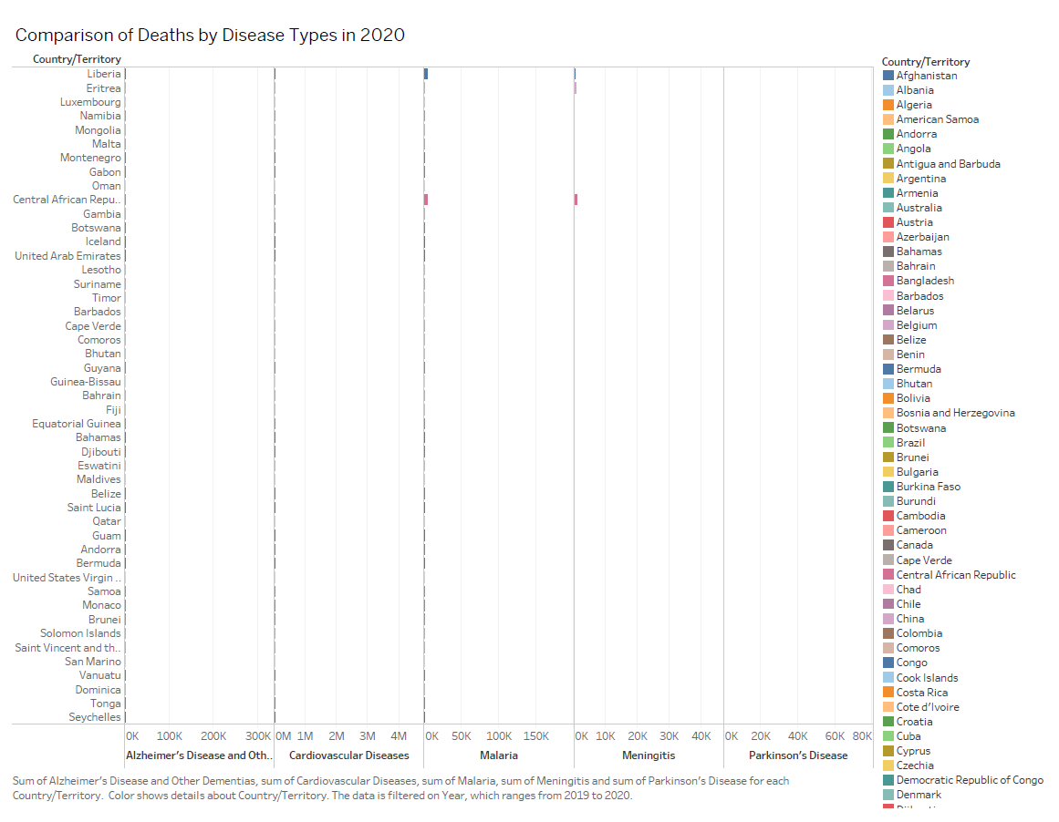
Implementation (Dashboard, Worksheet and Story) with screenshots

Slide 11
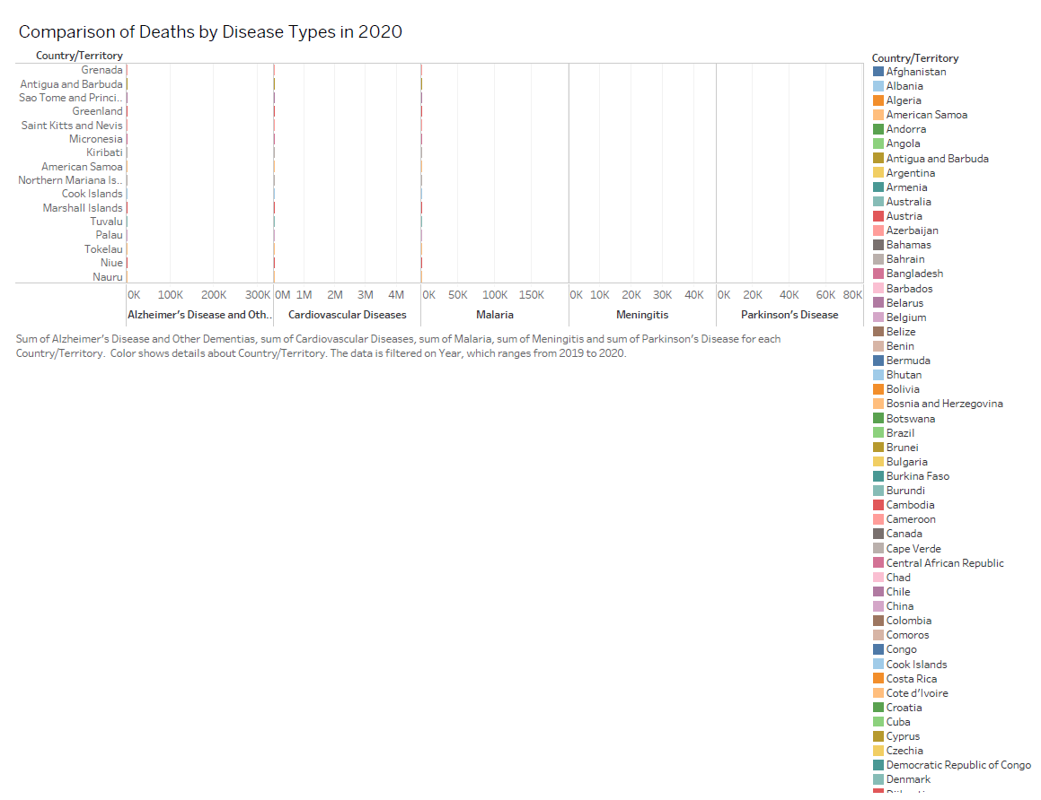
Implementation (Dashboard, Worksheet and Story) with screenshots

Slide 12
Justification of the analysis and visualization used
1. Trends Over Time
Justification: The line graphs showing trends of deaths from various diseases (e.g., Cardiovascular Diseases, Alzheimer's, Malaria) over time effectively depict changes and patterns across years. This visualization is suitable for understanding historical shifts in mortality rates and identifying peaks or declines linked to public health interventions or environmental factors.
Analysis:
Cardiovascular Diseases consistently show higher mortality rates compared to others, suggesting a critical area for intervention.
Diseases like Malaria display sporadic trends, likely influenced by localized outbreaks and control measures.
Alzheimer's Disease shows a gradual rise, indicating demographic shifts, such as aging populations.

Slide 13
Justification of the analysis and visualization used
2. Graph Chart for Geographic Analysis
Justification: The graph chart visualizes connections and relationships between regions (countries) and disease types. It is highly effective in representing multi-dimensional data such as disease burden across different countries.
Analysis:
The chart highlights countries with significant mortality burdens, like China, India, and the United States, linking them to major diseases such as Cardiovascular Diseases and Alzheimer’s.
Malaria is strongly associated with tropical countries, reflecting its environmental and healthcare dependencies.
Smaller nodes or connections reveal lesser-impacted regions, providing a comparative understanding of global disease distributions.

Slide 14
Justification of the analysis and visualization used
3. Bar Charts for Comparison by Disease Types
Justification: Bar charts are ideal for comparing the magnitude of deaths by different disease types across regions or countries. They offer a clear, straightforward view of quantitative differences, making it easy to spot trends and outliers. For instance, bar lengths directly convey the severity of the disease burden.
Analysis:
Global Trends: Cardiovascular Diseases dominate as the leading cause of death globally, represented by significantly taller bars. This reinforces their priority in global health initiatives.
Regional Insights:
Regions like tropical countries show notable bars for Malaria, aligning with the disease's geographic prevalence.
Developed countries tend to have higher bars for Alzheimer’s and Parkinson’s Diseases, likely due to longer life expectancies.
Meningitis appears as a moderate or low bar in most regions but may peak in specific areas where healthcare infrastructure is limited.
The comparison between diseases reveals disparities in healthcare challenges, guiding resource allocation effectively.

Slide 15
Recommendations
Clear Labels and Annotations: Use descriptive titles, axis labels, and annotations to highlight trends or anomalies, making charts easier to interpret.
Interactivity: Add filters and drill-down options to explore data by year, region, or disease, enhancing engagement and usability.
Normalized Metrics: Incorporate per capita data to provide fair comparisons across countries with different population sizes.
Diverse Visuals: Combine charts like line graphs for trends, bar charts for comparisons, and heatmaps for geographic analysis to present a comprehensive view.
Color and Accessibility: Use a colorblind-friendly palette and ensure visualizations are device-responsive for broader accessibility.

Slide 16
Conclusion
The visualizations provide valuable insights into global mortality trends and the impact of various diseases over time and across regions. The line charts effectively depict temporal trends, the graph charts illustrate regional interconnections, and the bar charts offer clear comparisons of disease burdens. Together, these tools highlight the critical health challenges, such as the dominance of Cardiovascular Diseases and the regional prevalence of diseases like Malaria.
By enhancing clarity, interactivity, and accessibility, and incorporating normalized metrics, these visualizations can become even more impactful. They serve as a powerful foundation for informed decision-making in public health policies and resource allocation.

